Slide 1
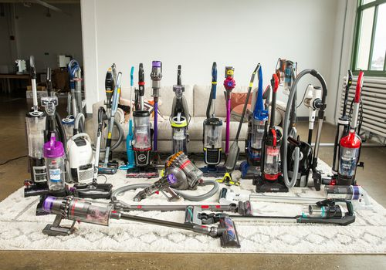
Vacuum War
Chen Zeshi
Ben Crosby
Tejas Ved
Wang Junce
Xue Kaisen
Zhao Lei

Slide 2
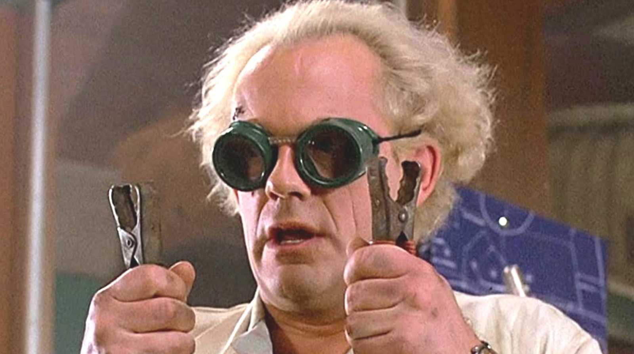
Tweaking the Vacuum Model
Family friendly mad scientist

Slide 3
DEMONSTRATION

Slide 4

Possibilities

Slide 5
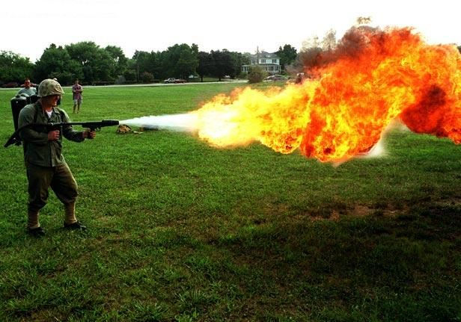
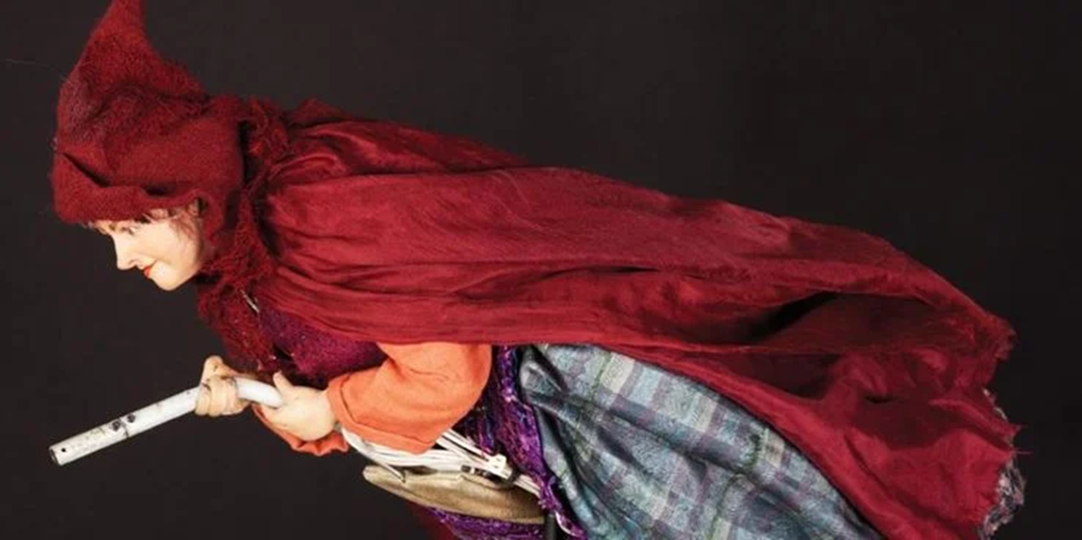
Marshmallow Roaster
Witch Car

Slide 6
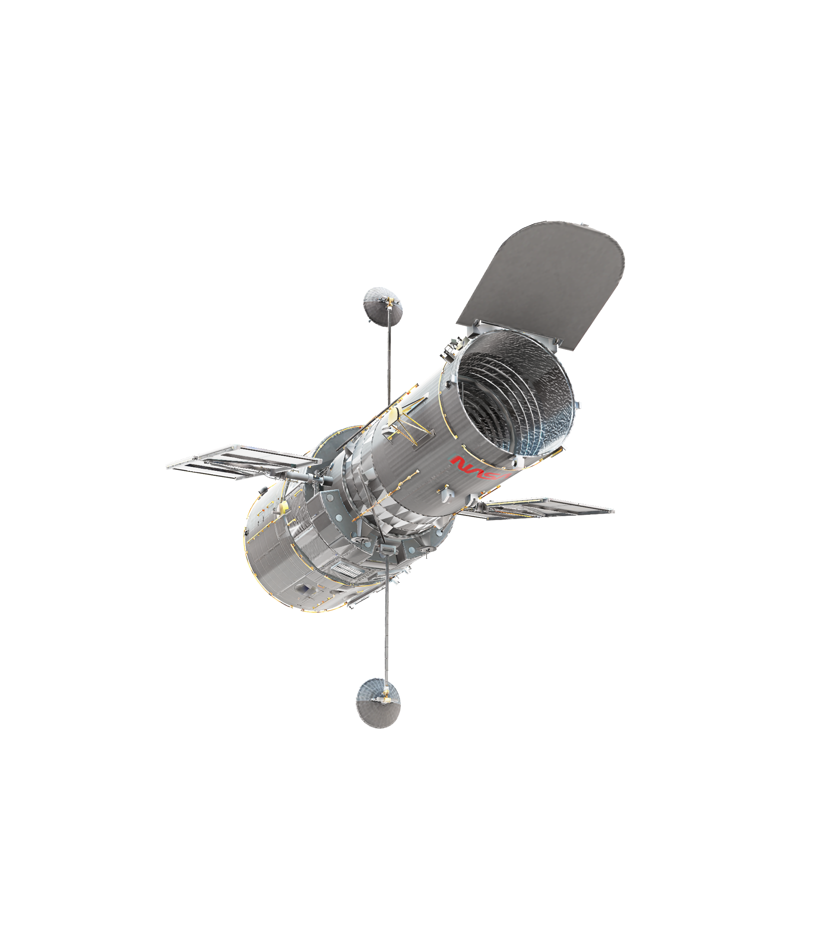
Slide 1

